Slide 1



SILVER
Structured Query Language
Structured Query Language
SQL is used to communicate with a database.
Icons made by wanicon from www.flaticon.com

Slide 2

Database and SQL Recap
BRONZE
bit.ly/SQLBronze
Image created by Alisher Y. source: https://commons.wikimedia.org/wiki/File:Kahoot.jpg

Slide 3
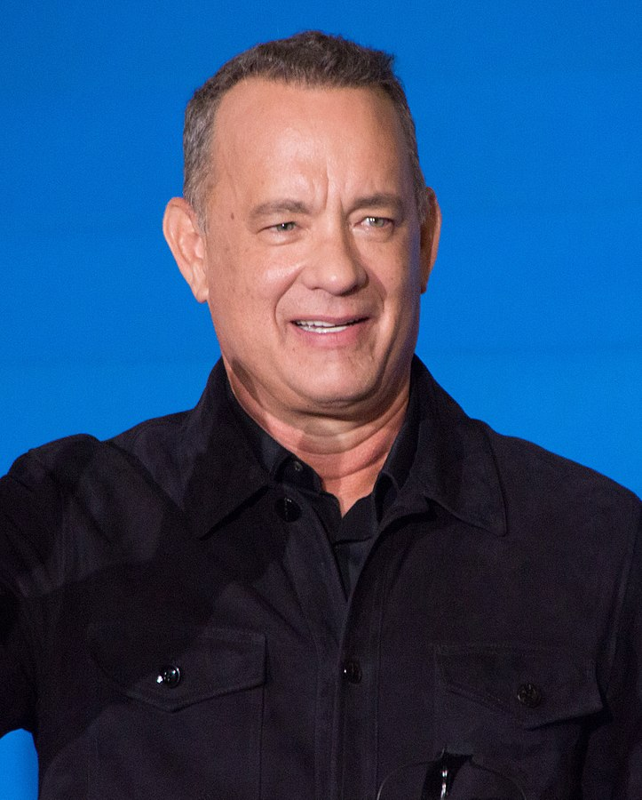

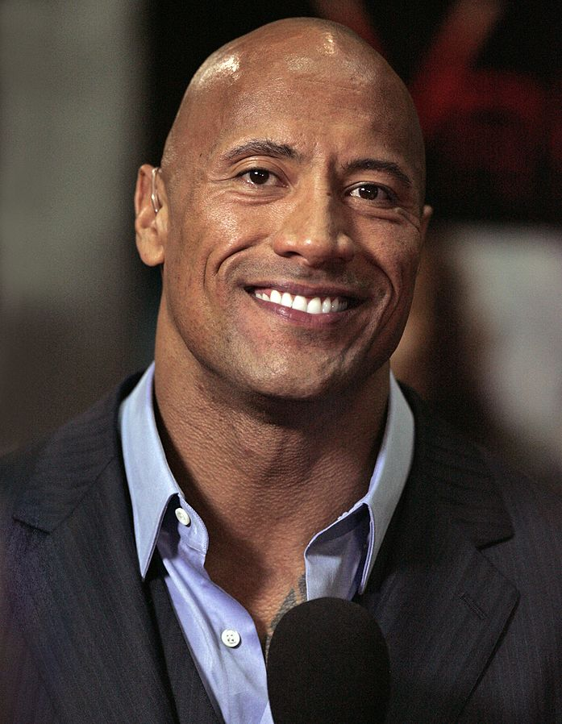

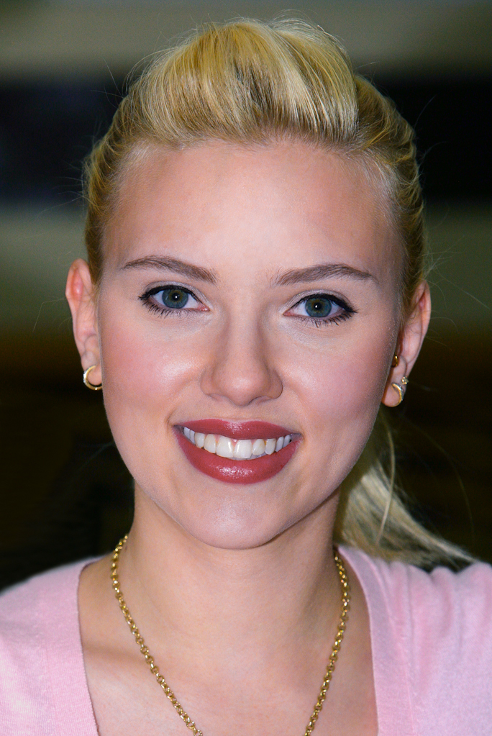
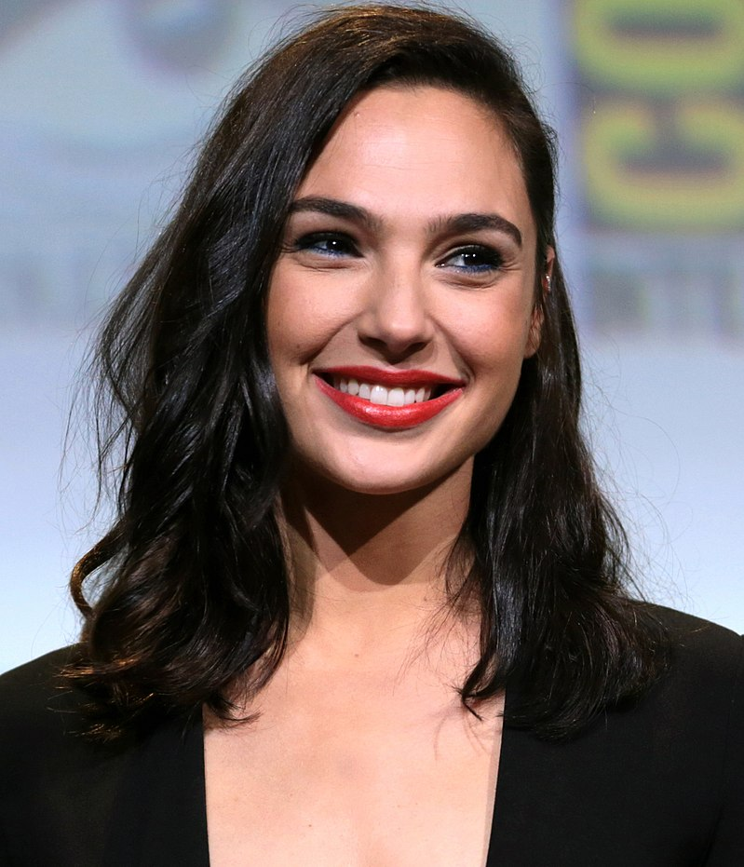


SQL ORDER BY
ORDER BY is used to sort the result-set in ascending or descending order. ORDER BY sorts the records in ascending order by default. To sort the records in descending order, use the DESC keyword.
TABLE FULLNAME: Celebrities
AGE: 63
GENDER: Male NATIONALITY: American
AGE: 24
GENDER: Male NATIONALITY: English
AGE: 48 GENDER: Male NATIONALITY American
AGE: 29
GENDER: Female NATIONALITY: Australian
AGE: 35
GENDER: Female NATIONALITY: American
AGE: 35
GENDER: Female NATIONALITY: Israeli
FULLNAME: Tom Hanks
FULLNAME: Tom Holland
FULLNAME: Dwayne Johnson
FULLNAME: Margot Robbie
FULLNAME: Scarlett Johansson
FULLNAME:
Gal Gadot
DEFINITION
SQL QUERY
If we ran this SQL query it would display the celebrities in ascending order by age.
SELECT *
FROM Celebrities ORDER BY AGE
Images from Wikimedia Commons and icon made by FreePik and SmashIcons from Flaticon

Slide 4
SQL ORDER BY
ORDER BY is used to sort the result-set in ascending or descending order. ORDER BY sorts the records in ascending order by default. To sort the records in descending order, use the DESC keyword.ASC A to Z or 1 to 100, DESC Z to A or 100 to 1.
TABLE FULLNAME: Celebrities
AGE: 24
GENDER: Male NATIONALITY: English
AGE: 29
GENDER: Female NATIONALITY: Australian
AGE: 35
GENDER: Female NATIONALITY: American
AGE: 35
GENDER: Female NATIONALITY: Israeli
AGE: 48 GENDER: Male NATIONALITY American
AGE: 63
GENDER: Male NATIONALITY: American
FULLNAME: Tom Holland
FULLNAME: Margot Robbie
FULLNAME: Scarlett Johansson
FULLNAME:
Gal Gadot
FULLNAME: Dwayne Johnson
FULLNAME: Tom Hanks
RESULTS
SQL QUERY
Celebrities are in ascending order by age; from youngest to oldest.
SELECT *
FROM Celebrities ORDER BY AGE
Images from Wikimedia Commons and icon made by FreePik and SmashIcons from Flaticon

Slide 5
SQL ORDER BY
ORDER BY is used to sort the result-set in ascending or descending order. ORDER BY sorts the records in ascending order by default. To sort the records in descending order, use the DESC keyword.ASC A to Z or 1 to 100, DESC Z to A or 100 to 1.
TABLE FULLNAME: Celebrities
AGE: 24
GENDER: Male NATIONALITY: English
AGE: 29
GENDER: Female NATIONALITY: Australian
AGE: 35
GENDER: Female NATIONALITY: American
AGE: 35
GENDER: Female NATIONALITY: Israeli
AGE: 48 GENDER: Male NATIONALITY American
AGE: 63
GENDER: Male NATIONALITY: American
FULLNAME: Tom Holland
FULLNAME: Margot Robbie
FULLNAME: Scarlett Johansson
FULLNAME:
Gal Gadot
FULLNAME: Dwayne Johnson
FULLNAME: Tom Hanks
DEFINITION
SQL QUERY
If we ran this SQL query it would display the celebrities in descending order by nationality.
SELECT *
FROM Celebrities ORDER BY NATIONALITY DESC
Images from Wikimedia Commons and icon made by FreePik and SmashIcons from Flaticon

Slide 6
SQL ORDER BY
ORDER BY is used to sort the result-set in ascending or descending order. ORDER BY sorts the records in ascending order by default. To sort the records in descending order, use the DESC keyword.ASC A to Z or 1 to 100, DESC Z to A or 100 to 1.
TABLE FULLNAME: Celebrities
AGE: 35
GENDER: Female NATIONALITY: Israeli
AGE: 24
GENDER: Male NATIONALITY: English
AGE: 29
GENDER: Female NATIONALITY: Australian
AGE: 48 GENDER: Male NATIONALITY American
AGE: 63
GENDER: Male NATIONALITY: American
AGE: 35
GENDER: Female NATIONALITY: American
FULLNAME:
Gal Gadot
FULLNAME: Tom Holland
FULLNAME: Margot Robbie
FULLNAME: Dwayne Johnson
FULLNAME: Tom Hanks
FULLNAME: Scarlett Johansson
RESULTS
SQL QUERY
Celebrities are in descending order by nationality.
SELECT *
FROM Celebrities ORDER BY NATIONALITY DESC
Images from Wikimedia Commons and icon made by FreePik and SmashIcons from Flaticon

Slide 7
SQL ORDER BY
ORDER BY is used to sort the result-set in ascending or descending order. ORDER BY sorts the records in ascending order by default. To sort the records in descending order, use the DESC keyword.ASC A to Z or 1 to 100, DESC Z to A or 100 to 1.
TABLE FULLNAME: Celebrities
AGE: 35
GENDER: Female NATIONALITY: Israeli
AGE: 29
GENDER: Female NATIONALITY: Australian
AGE: 48 GENDER: Male NATIONALITY American
AGE: 63
GENDER: Male NATIONALITY: American
AGE: 35
GENDER: Female NATIONALITY: American
AGE: 24
GENDER: Male NATIONALITY: English
FULLNAME:
Gal Gadot
FULLNAME: Margot Robbie
FULLNAME: Dwayne Johnson
FULLNAME: Tom Hanks
FULLNAME: Scarlett Johansson
FULLNAME: Tom Holland
DEFINITION
SQL QUERY
If we ran this SQL query it would display the celebrities in ascending order by age then ascending order by fullname.
SELECT *
FROM Celebrities ORDER BY AGE, FULLNAME
Images from Wikimedia Commons and icon made by FreePik and SmashIcons from Flaticon

Slide 8
SQL ORDER BY
ORDER BY is used to sort the result-set in ascending or descending order. ORDER BY sorts the records in ascending order by default. To sort the records in descending order, use the DESC keyword.ASC A to Z or 1 to 100, DESC Z to A or 100 to 1.
TABLE FULLNAME: Celebrities
AGE: 24
GENDER: Male NATIONALITY: English
AGE: 29
GENDER: Female NATIONALITY: Australian
AGE: 35
GENDER: Female NATIONALITY: Israeli
AGE: 35
GENDER: Female NATIONALITY: American
AGE: 48 GENDER: Male NATIONALITY American
AGE: 63
GENDER: Male NATIONALITY: American
FULLNAME: Tom Holland
FULLNAME: Margot Robbie
FULLNAME:
Gal Gadot
FULLNAME: Scarlett Johansson
FULLNAME: Dwayne Johnson
FULLNAME: Tom Hanks
RESULTS
SQL QUERY
The celebrities are sorted by ascending order by age (youngest to oldest) then ascending order by fullname (A to Z). Note Gal Gadot and Scarlett Johansson.
SELECT *
FROM Celebrities ORDER BY AGE, FULLNAME
Images from Wikimedia Commons and icon made by FreePik and SmashIcons from Flaticon

Slide 9

SQL ORDER BY
ORDER BY is used to sort the result-set in ascending or descending order. ORDER BY sorts the records in ascending order by default. To sort the records in descending order, use the DESC keyword.ASC A to Z or 1 to 100, DESC Z to A or 100 to 1.
TABLE FULLNAME: Celebrities
AGE: 24
GENDER: Male NATIONALITY: English
AGE: 29
GENDER: Female NATIONALITY: Australian
AGE: 35
GENDER: Female NATIONALITY: Israeli
AGE: 35
GENDER: Female NATIONALITY: American
AGE: 48 GENDER: Male NATIONALITY American
AGE: 63
GENDER: Male NATIONALITY: American
FULLNAME: Tom Holland
FULLNAME: Margot Robbie
FULLNAME:
Gal Gadot
FULLNAME: Scarlett Johansson
FULLNAME: Dwayne Johnson
FULLNAME: Tom Hanks
QUESTION
SQL QUERY
What would we change in this SQL query so when it ran it would sort the celebrities alphabetically by fullname?
SELECT *
FROM Celebrities ORDER BY AGE, FULLNAME
Images from Wikimedia Commons and icon made by FreePik and SmashIcons from Flaticon

Slide 10
SQL ORDER BY
ORDER BY is used to sort the result-set in ascending or descending order. ORDER BY sorts the records in ascending order by default. To sort the records in descending order, use the DESC keyword.ASC A to Z or 1 to 100, DESC Z to A or 100 to 1.
TABLE FULLNAME: Celebrities
AGE: 48 GENDER: Male NATIONALITY American
AGE: 35
GENDER: Female NATIONALITY: Israeli
AGE: 29
GENDER: Female NATIONALITY: Australian
AGE: 35
GENDER: Female NATIONALITY: American
AGE: 63
GENDER: Male NATIONALITY: American
AGE: 24
GENDER: Male NATIONALITY: English
FULLNAME: Dwayne Johnson
FULLNAME:
Gal Gadot
FULLNAME: Margot Robbie
FULLNAME: Scarlett Johansson
FULLNAME: Tom Hanks
FULLNAME: Tom Holland
ANSWER
SQL QUERY
We would have to change the order by field to fullname.
SELECT *
FROM Celebrities ORDER BY FULLNAME
Images from Wikimedia Commons and icon made by FreePik and SmashIcons from Flaticon

Slide 11
SQL ORDER BY
ORDER BY is used to sort the result-set in ascending or descending order. ORDER BY sorts the records in ascending order by default. To sort the records in descending order, use the DESC keyword.ASC A to Z or 1 to 100, DESC Z to A or 100 to 1.
TABLE FULLNAME: Celebrities
AGE: 48 GENDER: Male NATIONALITY American
AGE: 35
GENDER: Female NATIONALITY: Israeli
AGE: 29
GENDER: Female NATIONALITY: Australian
AGE: 35
GENDER: Female NATIONALITY: American
AGE: 63
GENDER: Male NATIONALITY: American
AGE: 24
GENDER: Male NATIONALITY: English
FULLNAME: Dwayne Johnson
FULLNAME:
Gal Gadot
FULLNAME: Margot Robbie
FULLNAME: Scarlett Johansson
FULLNAME: Tom Hanks
FULLNAME: Tom Holland
QUESTION
SQL QUERY
What would we change in this SQL query so when it ran it would sort the celebrities by fullname going from Z-A?
SELECT *
FROM Celebrities ORDER BY FULLNAME
Images from Wikimedia Commons and icon made by FreePik and SmashIcons from Flaticon

Slide 12
SQL ORDER BY
ORDER BY is used to sort the result-set in ascending or descending order. ORDER BY sorts the records in ascending order by default. To sort the records in descending order, use the DESC keyword.ASC A to Z or 1 to 100, DESC Z to A or 100 to 1.
TABLE FULLNAME: Celebrities
AGE: 24
GENDER: Male NATIONALITY: English
AGE: 63
GENDER: Male NATIONALITY: American
AGE: 35
GENDER: Female NATIONALITY: American
AGE: 29
GENDER: Female NATIONALITY: Australian
AGE: 35
GENDER: Female NATIONALITY: Israeli
AGE: 48 GENDER: Male NATIONALITY American
FULLNAME: Tom Holland
FULLNAME: Tom Hanks
FULLNAME: Scarlett Johansson
FULLNAME: Margot Robbie
FULLNAME:
Gal Gadot
FULLNAME: Dwayne Johnson
ANSWER
SQL QUERY
We would have to add DESC after fullname.
SELECT *
FROM Celebrities ORDER BY FULLNAME DESC
Images from Wikimedia Commons and icon made by FreePik and SmashIcons from Flaticon

Slide 13
SQL ORDER BY
ORDER BY is used to sort the result-set in ascending or descending order. ORDER BY sorts the records in ascending order by default. To sort the records in descending order, use the DESC keyword.ASC A to Z or 1 to 100, DESC Z to A or 100 to 1.
TABLE FULLNAME: Celebrities
AGE: 48 GENDER: Male NATIONALITY American
AGE: 35
GENDER: Female NATIONALITY: Israeli
AGE: 29
GENDER: Female NATIONALITY: Australian
AGE: 35
GENDER: Female NATIONALITY: American
AGE: 63
GENDER: Male NATIONALITY: American
AGE: 24
GENDER: Male NATIONALITY: English
FULLNAME: Dwayne Johnson
FULLNAME:
Gal Gadot
FULLNAME: Margot Robbie
FULLNAME: Scarlett Johansson
FULLNAME: Tom Hanks
FULLNAME: Tom Holland
QUESTION
SQL QUERY
What would we change in this SQL query so when it ran it display the age and gender of celebrities and order them by age from oldest to youngest?
SELECT
FROM Celebrities ORDER BY FULLNAME
Images from Wikimedia Commons and icon made by FreePik and SmashIcons from Flaticon

Slide 14
SQL ORDER BY
ORDER BY is used to sort the result-set in ascending or descending order. ORDER BY sorts the records in ascending order by default. To sort the records in descending order, use the DESC keyword.ASC A to Z or 1 to 100, DESC Z to A or 100 to 1.
TABLE FULLNAME: Celebrities
AGE: 24
GENDER: Male NATIONALITY: English
AGE: 29
GENDER: Female NATIONALITY: Australian
AGE: 35
GENDER: Female NATIONALITY: American
AGE: 35
GENDER: Female NATIONALITY: Israeli
AGE: 48 GENDER: Male NATIONALITY America
AGE: 63
GENDER: Male NATIONALITY: American
FULLNAME: Tom Holland
FULLNAME: Margot Robbie
FULLNAME: Scarlett Johansson
FULLNAME:
Gal Gadot
FULLNAME: Dwayne Johnson
FULLNAME: Tom Hanks
ANSWER
SQL QUERY
We would have to change fields to select to age and gender and change the order by field to age.
SELECT AGE, GENDER
FROM Celebrities
ORDER BY AGE
Images from Wikimedia Commons and icon made by FreePik and SmashIcons from Flaticon

Slide 15




SQL ORDER BY
START HERE
RUNNING QUERIES IN A DATABASE
Sign in to repl.it
Then go to this link bit.ly/SQLPlanets
A database about planets has already been made for you. Your task is to run the 7 queries detailed below.
In this activity, you will run queries on a database about planets. You will use the SQL commands: order by
Displays all data from table and orders the data by column specified in ascending order.
QUERIES
SELECT * FROM table_fullname ORDER BY column_name
Display all of the data of the planets ordered by planet name in ascending order.
Display all of the data of the planets ordered by planet name in descending order.
Display all of the data of the planets ordered by the number of moons and then by the planet name in ascending order.
Display the planet ame, number of moons and year discovered but order results by the number of moons in descending order.
Display all of the data of the planets and order by distance from the sun in descending order.
Display all of the data of the planets that Galileo Galilei discovered and order by distance from the sun in ascending order.
Display only the planet name and year discovered of the planets that were NOT discovered by Galileo Galilei. Display the results in descending order by year discovered.
Displays all data from table and orders the data by column specified in descending order.
SELECT * FROM table_name ORDER BY column_name DESC
Displays all the data from table and orders by first column then by the second column in ascending order.
SELECT * FROM table_name ORDER BY column_name, column_name
Displays specific column from table and orders by column specified in ascending order.
SELECT column_name, column_name FROM table_name ORDER BY column_name
Icon made by FlatIcon and FreePik from Flaticon

Slide 16

SQL Commands
SILVER
bit.ly/SQLSilver
Image from https://commons.wikimedia.org/wiki/File:Quizlet_Logo.svg

Slide 17




SQL MURDER MYSTERY
SQL MURDER MYSTERY
SILVER
FIND THE CRIMINAL
START HERE
Open the link bit.ly/SQLMMRepl
Look at your firstClue and the tableColumns to help you begin to complete your detective notes that you can find at bit.ly/SQLMMNotes
Use the bit.ly/SQLCheatSheets to help you.
In this activity, you will use your knowledge of SQL commands to complete the 19 short tasks. Your goal is to identify who the criminal is.
DID YOU IDENTIFY THE MURDERER CORRECTLY?
Challenge yourself to complete the extra 3 tasks and find out who is the brains of the operation? Once you’ve identified them, check your answer with the same code as you used to check your answer for the murder mystery.
SQL Murder Mystery task full credit to KnightLab, Joon Park and Cathy He. https://mystery.knightlab.com/ Icons made by FreePik, FlatIcon from www.flaticon.com

Slide 18
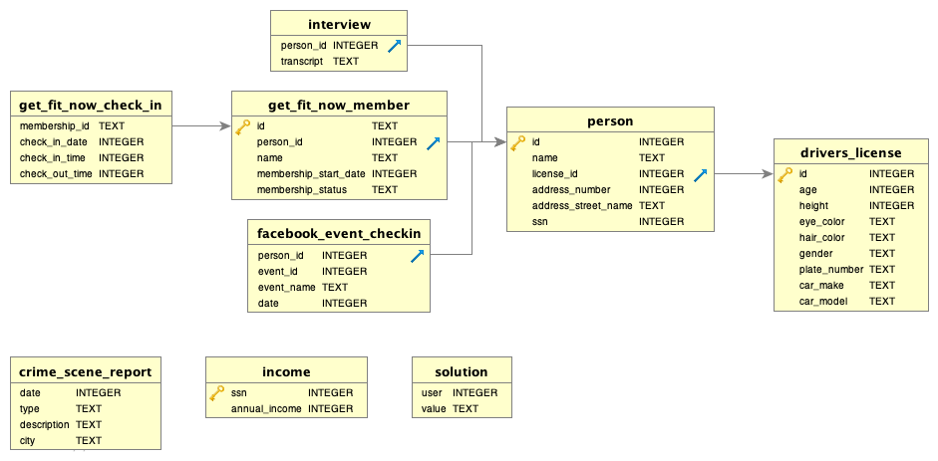
SQL MURDER MYSTERY
SQL MURDER MYSTERY
SILVER
TABLES AND COLUMNS
SQL Murder Mystery task full credit to KnightLab, Joon Park and Cathy He. https://www.sql-island-touch.de Icons made by FreePik from www.flaticon.com

Slide 19

SQL MURDER MYSTERY
SQL MURDER MYSTERY
SILVER
FIRST CLUE...
A crime has taken place and the detective needs your help. The detective gave you the crime scene report, but you somehow lost it. You vaguely remember that the crime was a ​murder​ that occurred sometime on ​Jan.15, 2018​ and that it took place in ​SQL City​. Start by retrieving the corresponding crime scene report from the police department’s database. All the clues to this mystery are buried in a huge database, and you need to use SQL to navigate through this vast network of information. Your first step to solving the mystery is to retrieve the corresponding crime scene report from the police department’s database.
SQL Murder Mystery task full credit to KnightLab, Joon Park and Cathy He. https://www.sql-island-touch.de Icons made by FreePik and Nhor Phai from www.flaticon.com

